Slide 1

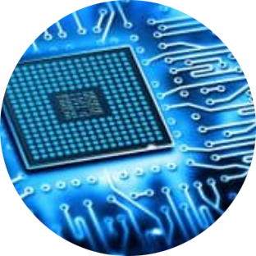
Virtual Memory
Abu Musa Sakib 1810617 (Slide 01-10)
Sumyia Afnan Mukta 1810668 (Slide 11-19)
Md. Ashikur Rahman 1831110 (Slide 20-29)
Fatematuz Jahura 1830481 (Slide 30-39)

Slide 2
Topics covered:
Introduction
Uses of Virtual Memory
Origin of Virtual Memory
Address and Memory Space
Concept
Illustration
Locality of Reference and its types
Swapping
Address Mapping
Page Fault
Page Replacement Algorithms: FIFO, LRU, OPT
Difference and Modularity between
Virtual Memory and Physical Memory
Classification of Virtual Memory
Paging and Segmentation difference
Thrashing
Management of Virtual Memory
Advantages and Disadvantages

Slide 3
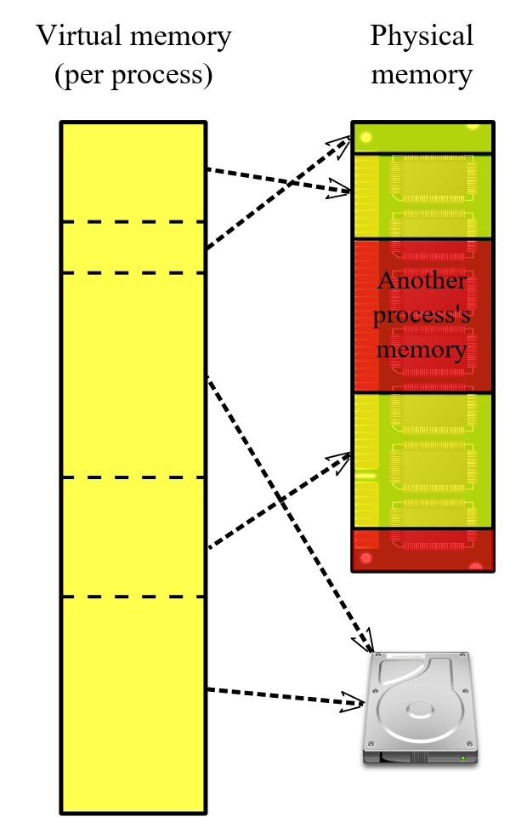
INTRODUCTION
Virtual memory is a memory management technique which uses a section of the hard disk giving the illusion of having much more memory than the physical memory installed on the system.
Notes:
A computer can address more memory than the amount physically installed on the system. This extra memory is called virtual memory and it is a section of a hard disk that's set up to emulate the computer's RAM. (http://tutorialspoint.com/operating_system/os_virtual_memory.htm)
virtual memory, virtual storage^{[b]} or swap memory^{[3]} is a memory management technique that provides an "idealized abstraction of the storage resources that are actually available on a given machine"^{[4]} which "creates the illusion to users of a very large (main) memory". (https://en.wikipedia.org/wiki/Virtual_memory)
What is Virtual Memory and How Does It Work? (techtarget.com)
What is Virtual Memory and Why Do We Need It – Utilize Windows

Slide 4
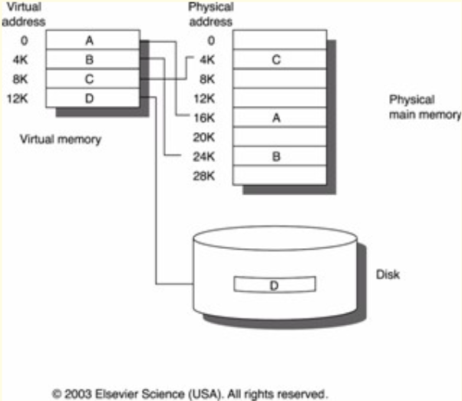
Uses of Virtual Memory
Isolating to make the physical memory visible.
Implement memory protection from error.
Implement shared memory communication.
RAM extended by virtual memory.
No process and page limitation for process.
Due to the advantage of Virtual memory, it is used in Mac/iOS, Linux, Windows etc.
The way Virtual memory used in Linux is quite complex.
Notes:
Decouples size of physical memory from programmer visible virtual memory.
Provides a convenient point to implement memory protection.
Creates a flexible mechanism to implement shared memory communication.
A programmer can write a program which requires more memory space than the capacity of the main memory. Such a program is executed by virtual memory technique.
No limitation on processes & number of pages in each process although the main memory is finite (Example: 8 GB, 16 GB etc.)

Slide 5
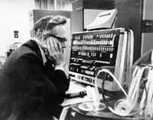
Origin of Virtual Memory
First true virtual memory system: Part of Atlas Computer
Before virtual memory : Dynamic address required.
IBM research team’s conclusion : Overlay system worked overall better than manually controlled systems.
First minicomputer : Part of virtual memory, notably VAX models running VMS.
Introduced: Through Intel 80286 processor.
Notes:
The first true virtual memory system was that implemented at the University of Manchester to create a one-level storage system^{[13]} as part of the Atlas Computer. It used a paging mechanism to map the virtual addresses available to the programmer on to the real memory that consisted of 16,384 words of primary core memory with an additional 98,304 words of secondary drum memory.
Before virtual memory could be implemented in mainstream operating systems, many problems had to be addressed. Dynamic address translation required expensive and difficult-to-build specialized hardware; initial implementations slowed down access to memory slightly.^{[8]} There were worries that new system-wide algorithms utilizing secondary storage would be less effective than previously used application-specific algorithms.
By 1969, the debate over virtual memory for commercial computers was over;^{[8]} an IBM research team led by David Sayre showed that their virtual memory overlay system consistently worked better than the best manually controlled systems.
The first minicomputer to introduce virtual memory was the Norwegian NORD-1; during the 1970s, other minicomputers implemented virtual memory, notably VAX models running VMS.
Virtual memory was introduced to the x86 architecture with the protected mode of the Intel 80286 processor, but its segment swapping technique scaled poorly to larger segment sizes. The Intel 80386 introduced paging support underneath the existing segmentation layer, enabling the page fault exception to chain with other exceptions without double fault.
(https://en.wikipedia.org/wiki/Virtual_memory#History)

Slide 6
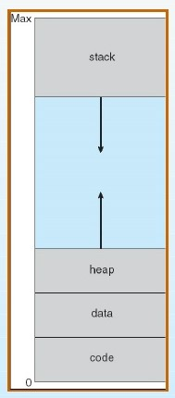
Address and Memory Space
A virtual address enables to use primary storage (main memory).
It’s free from other processes and to use more space by relegating contents to hard disk.
An address in main memory is called a location. The set of such locations is called the memory space.
It is the memory that a program can access.
The memory can be either physical or virtual and is used for executing instructions and storing data.
Notes:
A virtual address is a binary number in virtual memory that enable a process to use a location in primary storage (main memory) independently of other processes and to use more space that actually exists in primary storage by temporarily relegating some contents to a hard disk.
An address in main memory is called a location or physical address. The set of such locations in main memory is called the memory space or physical memory.
It’s a range of valid addresses in memory that are available for a program or process. So, it is the memory that a program can access.
The memory can be either be physical or virtual and is used for executing instructions and storing data.

Slide 7
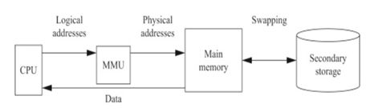
Concept
There are two parts:
1. Main memory: RAM
2. Secondary memory: Hard Disk
The memory management unit (MMU)
creates a pathway between the
main memory and the secondary
memory which is called Swapping.
Notes:
Hard disk is like a warehouse of storage which is larger than RAM, but hard disk is slower than RAM.
The memory management unit (MMU) transfers the currently needed part of the program from the secondary memory to the main memory for execution.
This to from movement of instruction and data (parts of a program) between the main memory and the secondary memory is called Swapping.

Slide 8
Illustration
Main Memory
Page 1 of Process 1
Page 4 of Process 2
Page 1 of Process 2
Page 5 of Process 3
Page 1 of Process 3
Page 2 of Process 2
Page 3 of Process 1
Process 1 | Process 2 | Process 3
Page 1 | Page 1 | Page 1
Page 2 | Page 2 | Page 2
Page 3 | Page 3 | Page 3
Page 4 | Page 4 | Page 4
Page 5 | Page 5 | Page 5
Swap In/ Swap Out
CPU
Logical Address Space

Slide 9
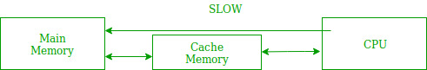
Locality of Reference
Tendency of processor to retrieve same set of memory locations continuously and more frequently.
Types:
1. Temporal: Access recently used.
2. Spatial: Involve clustered memory locations.
3. Sequential: Arranged and accessed linearly.
Notes:
The tendency of a processor to access the same set of memory locations repetitively
over a short period of time.
Temporal locality refers to the tendency for a processor to access memory locations
that have been used recently.
Spatial locality refers to the tendency of execution to involve a number of
memory locations that are clustered.
Sequential locality, a special case of spatial locality, occurs when data elements are arranged and accessed linearly, such as, traversing the elements in a one-dimensional array.
Principle of Locality: Programs tend to use data and instructions with addresses near or equal to those they have used recently.
Temporal Locality: Recently referenced items are likely to be referred again in the near future.
Spatial Locality: Items with nearby addresses tend to be referenced close together in time.

Slide 10
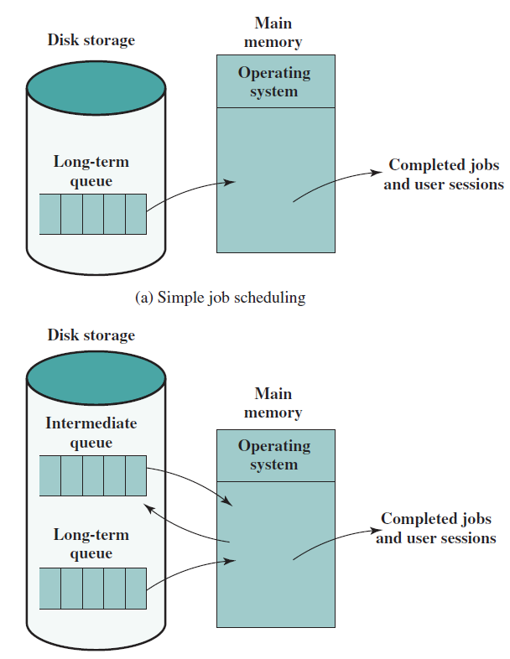
Swapping
The process of moving data from RAM to disk (and back) is known as swapping or paging.
There are 3 types of queues:
Long term queue: requests for new processes.
Short term queue: Ready to use instantly.
I/O queue: not ready to use.
Swapping: Process (Stored in RAM) Long term queue (Stored in disk) Disk.
The Virtual Memory Manager (VMM) oversees swapping data between physical memory and the hard disk.
Swapping allows multiple programs to run parallelly in the operating system
Notes:
Picture(book pg.284 .slide307)

Slide 11
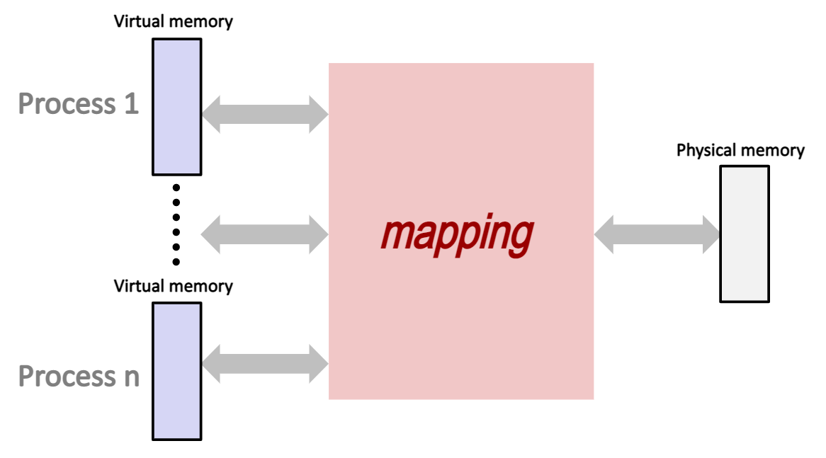
Process of Mapping in virtual memory
Logical address (generated by CPU) = Logical page number + location within the page (x).
Mappers map logical address into main memory address.
CPU can get the required data, if the page is present in main memory.
Notes:
1.CPU generates logical address consisting of a logical page number plus the location within that page (x).
2.It must be mapped onto an actual (physical) main memory address by the operating system using mapper.
3.If the page is present in the main memory, CPU gets the requires data from the main memory.

Slide 12
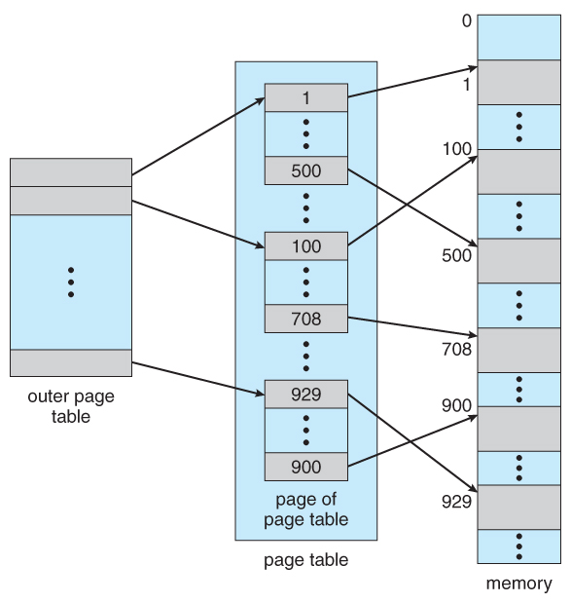
Address Mapping Using Memory Mapping Page Table
If the mapper detects that the requested page is not present in the main memory, a page fault occurs, and the page must be read from secondary storage(4,5)
If empty page frame is not available, then a page must be removed
from page frame in main memory.
Notes:
When the process references a page, and it’s unable to find the requested page in main, the processor treats it as a page fault, and transfers control of the program from the operating system. The operating system tries to read the page from hard disk. It should also get an empty page frame in RAM as a data container. If it is not possible to get an empty page frame, then the page referred by the process must be deleted from main memory.

Slide 13
PAGE FAULT
Main Memory
Page 1 of Process 1
Page 4 of Process 2
Page 1 of Process 2
Page 5 of Process 3
Page 1 of Process 3
Page 2 of Process 2
Page Table of P1
f1
---
---
Process 1 | Process 2 | Process 3
Page 1 | Page 1 | Page 1
Page 2 | Page 2 | Page 2
Page 3 | Page 3 | Page 3
Page 4 | Page 4 | Page 4
Page 5 | Page 5 | Page 5
CPU
Logical Address Space

Slide 14
PAGE FAULT SERVICE
Operating System
Main Memory
Page 1 of Process 1
Page 4 of Process 2
Page 1 of Process 2
Page 5 of Process 3
Page 1 of Process 3
Page 2 of Process 2
Page Title of P1
f1
---
---
Process 1 | Process 2 | Process 3
Page 1 | Page 1 | Page 1
Page 2 | Page 2 | Page 2
Page 3 | Page 3 | Page 3
Page 4 | Page 4 | Page 4
Page 5 | Page 5 | Page 5
CPU
Logical Address Space

Slide 15
PAGE FAULT SERVICE
Operating System
Main Memory
Page 1 of Process 1
Page 4 of Process 2
Page 1 of Process 2
Page 5 of Process 3
Page 1 of Process 3
Page 2 of Process 2
Page 2 of Process 1
Page Title of P1
Frame 1
Frame 8
---
Process 1 | Process 2 | Process 3
Page 1 | Page 1 | Page 1
Page 2 | Page 2 | Page 2
Page 3 | Page 3 | Page 3
Page 4 | Page 4 | Page 4
Page 5 | Page 5 | Page 5
CPU
Logical Address Space

Slide 16
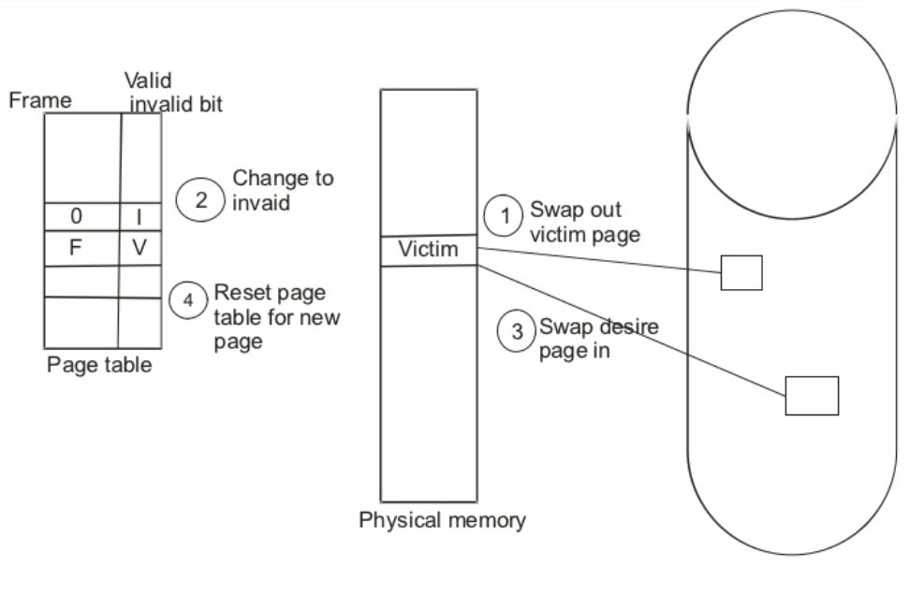
Page Replacement Algorithms
Replacing the pages of the processes when there’s not enough frame to store data.
This process of removal is done using replacement algorithms like FIFO, LIFO, MRU etc.
The more important data is given higher priority in RAM and least important one gets sent back to disk using “Swapping out”.
Notes:
In an operating system that uses paging for memory management, a page replacement algorithm is needed to decide which page needs to be replaced when new page comes in.
If there is not enough frame where we can store the needed address or data, we replace the pages of the processes and remove data from RAM and write to disk in order to provide space for data of higher priority to store in RAM.
This process of removal is done using certain algorithms like FIFO, LIFO, MRU etc. which are called page replacement algorithms.
In all the algorithms, the more important data is given higher priority in RAM and least important one gets sent back to disk using “swapping out”.
In a computer operating system that uses paging for virtual memory management, page replacement algorithms decide which memory pages to page out (swap out, write to disk) when a page of memory needs to be allocated.
Paging happens when a page fault occurs and a free page cannot be used to satisfy the allocation, either because there are none, or because the number of free pages is lower than some threshold.

Slide 17
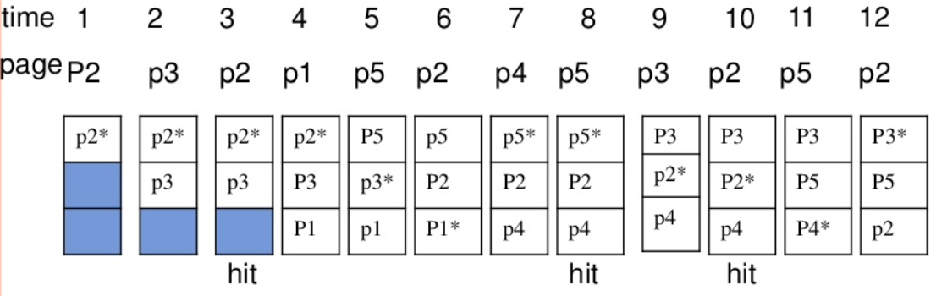
FIFO (First-In-First-Out )
Selects the page for replacement that has
been in memory the longest time.
The operating system keeps track of all pages
in a queue, the oldest page is in the front of the queue.
When a page needs to be replaced page
in the front of the queue is selected for removal.
Removed page can be easily determined because its identification number is at the top of the FIFO queue.
Notes:
FIFO means First-in-first out. As I have said in the previous slide it is a page replacement algorithm. The FIFO algorithm selects the page for replacement that has been in the memory for longest time.
In this algorithm, the operating system keeps track of all pages in the memory in a queue, the oldest page is in the front of the queue. When a page needs to be replaced in the front of the queue is selected for remove. When there is a need for page replacement, the FIFO algorithm, swaps out the page at the front of the queue, that is the page which has been in the memory for the longest time.
When a new page must be loaded, the page recently brought in is removed. The page to be removed is easily determined because its identification number is at the top of the FIFO queue..
https://www.slideshare.net/sashi799/page-replacement-5025792
https://afteracademy.com/blog/what-are-the-page-replacement-algorithms

Slide 18
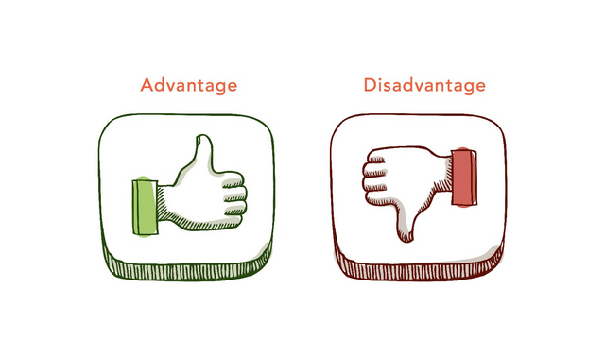
Advantages and Disadvantages of FIFO
Advantages:
Simple and easy to implement.
Low overhead.
Disadvantages:
Poor performance.
Doesn’t consider the frequency of use or last used time, simply replaces the oldest page.
Suffers from Belady’s Anomaly
Notes:
Everything has some advantage and disadvantage . As like FIFO too. Its advantages are it is very Simple, Easy to understand and execute. The FIFO replacement policy has the advantage of being easy to implement. Under FIFO, purchases at the end of the period have no effect on cost of goods sold or net income.
It has the disadvantage that under certain circumstances pages are removed and loaded from memory too frequently.
A page which is being accessed often may also get replaced because it arrived earlier than those present.
A page which was referenced last may also get replaced, although there is high probability that the same page may be needed again .
So that the system needs to keep track of each frame. Sometimes it behaves abnormally. This behavior is called Belady's anomaly. Bad replacement choice increases the page fault rate and slow process execution.
The process effectiveness is low. When we increase the number of frames while using FIFO, we are giving more memory to processes. So, page fault should decrease, but here the page faults are increasing.

Slide 19
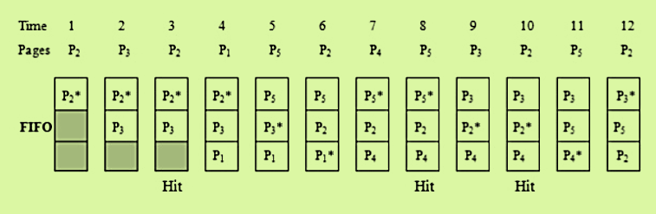
FIFO Algorithm
Consider a paging system having capacity of 3 pages. The execution of a program requires references to five distinct pages P1, P2, P3, P4 and P5. The pages are executed in the following sequence:
P2 P3 P2 P1 P5 P2 P4 P5 P3 P2 P5 P2

Slide 20
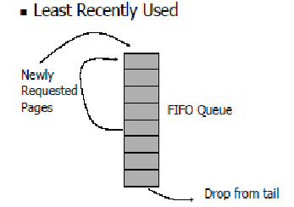
Least Recently Used (LRU)
Tracks page usage frequently.
Keeping a counter along with every page
in main memory.
Referred page’s associated counter set to 0,
and at a certain interval, all page counters incremented by 1.
The pages whose count is high is least used
which are called aging registers.
Notes:
In operating systems that use paging for memory management, page replacement algorithm is needed to decide which page needed to be replaced when new page comes in. Whenever a new page is referred and not present in memory, page fault occurs and Operating System replaces one of the existing pages with newly needed page. Different page replacement algorithms suggest different ways to decide which page to replace. The target for all algorithms is to reduce number of page faults.
http://www.mathcs.emory.edu/~cheung/Courses/355/Syllabus/9-virtual-mem/LRU-replace.html
LRU means least recently used page. It is also a page replacement algorithm keeps track of the page usage over a short period of time.
The LRU algorithm can be implemented by associating a counter with every page that is in main memory.
When a page is referenced, its associated counter is set to 0. At fixed intervals of time, the counters associated with all pages presently in memory are incremented by 1.
The least recently used page is the page with the highest count. The counters are often called aging registers, as their count indicates their age, that is, how long their associated pages have been referenced.

Slide 21
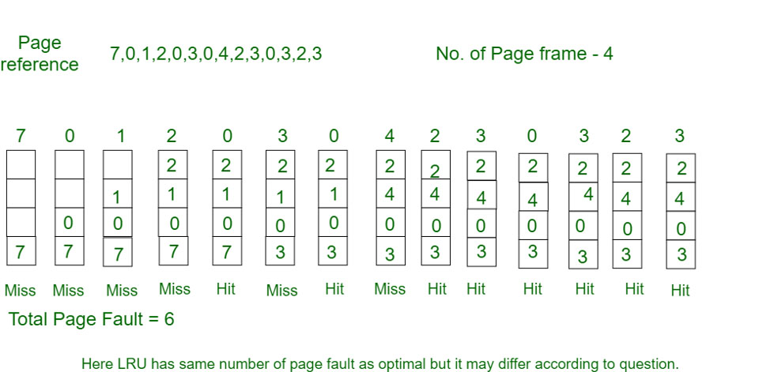
Simulation of Least Recently Used (LRU)

Slide 22
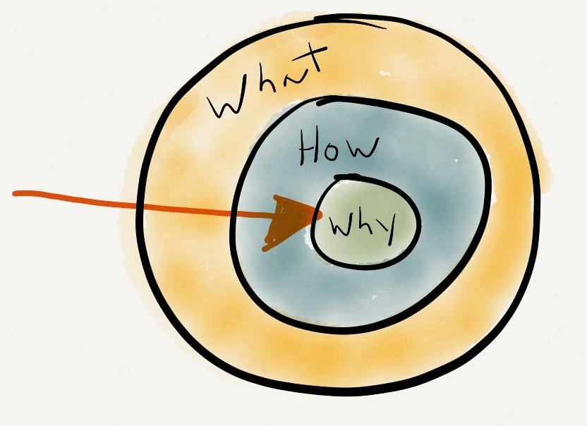
Working process of Least Recently Used (LRU)
Initially all slots are empty, so when 7 0 1 2 are allocated to the empty slots —> 4 Page faults
0 is already their so —> 0 Page fault.
When 3 came it will take the place of 7 because it is least recently used —>1 Page fault
0 is already in memory so —> 0 Page fault.
4 will takes place of 1 —> 1 Page Fault
Now for the further page reference string —> 0 Page fault because they are already available in the memory.

Slide 23
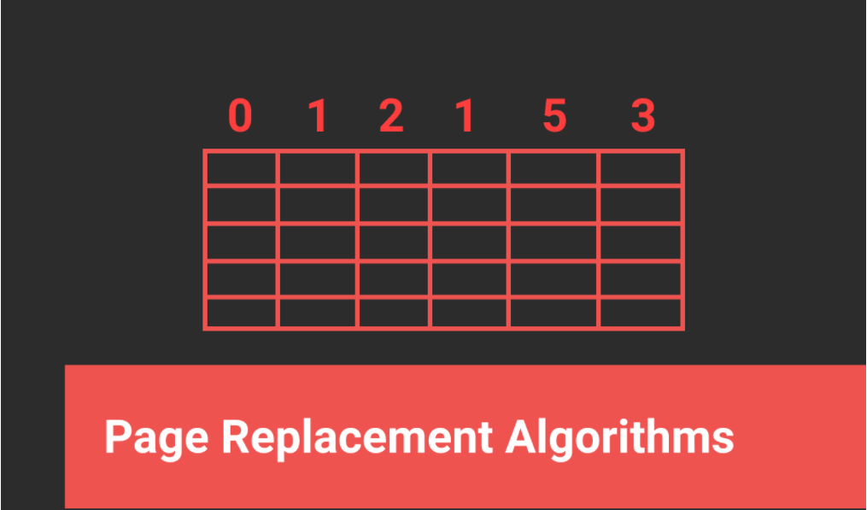
Optimal Page Replacement Algorithm
Pages are replaced for the longest duration of time.
Optimal page replacement is perfect, but difficult to implement.
Optimal Page replacement is considered as standard model for another algorithm.
Notes:
Optimal page replacement is perfect, but difficult to implement.
In this algorithm, pages are replaced which would not be used for the longest duration of time.
Optimal page replacement is perfect, but difficult to implement. As it is not aware of the future request.
The use of Optimal Page replacement is to set up a benchmark. So that it can be considered as standard model for another algorithm.

Slide 24
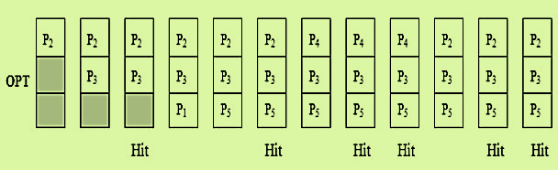
Optimal (OPT)
Consider a paging system having capacity of 3 pages. The execution of a program requires references to five distinct pages P1, P2, P3, P4 and P5. The pages are executed in the following sequence:
P2 P3 P2 P1 P5 P2 P4 P5 P3 P2 P5 P2

Slide 25
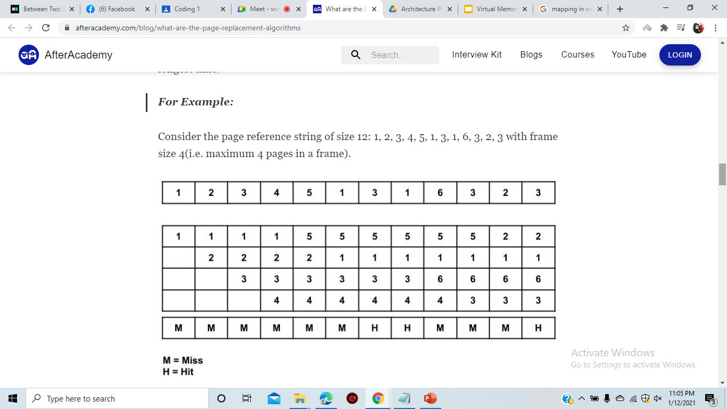
Advantages and Disadvantages of OPT
Advantages of OPT:
Simple data structures are used.
Highly efficient.
Disadvantages of OPT:
Requires future knowledge of the program.
Time-consuming.
Notes:
1.The optimal policy selects that page for replacement for which the time to the next reference is longest.
2.This algorithm results in fewest number of page faults. But this algorithm is impossible to implement.
3.At the time of page fault, the operating system has no way of knowing when each of the pages will be referenced next. However, it does serve as a standard against which to judge other algorithms.

Slide 26

Simulation of Optimal Page Replacement Algorithm

Slide 27

Working process of Optimal Page Replacement
Pages are replaced which would not be used for the longest duration of time in the future.
Initially all slots are empty, so when 7 0 1 2 are allocated to the empty slots —> 4 Page faults.
0 is already there so —> 0 Page fault. when 3 came it will take the place of 7 because it is least recently used —>1 Page fault
0 is already in memory so —> 0 Page fault.
Notes:
In this algorithm, pages are replaced which would not be used for the longest duration of time in the future.

Slide 28
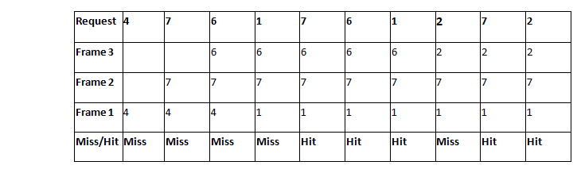
Working process of Optimal Page Replacement
4 will takes place of 1 —> 1 Page Fault
Now for the further page reference string —> 0 Page fault because they are already available in the memory.

Slide 29
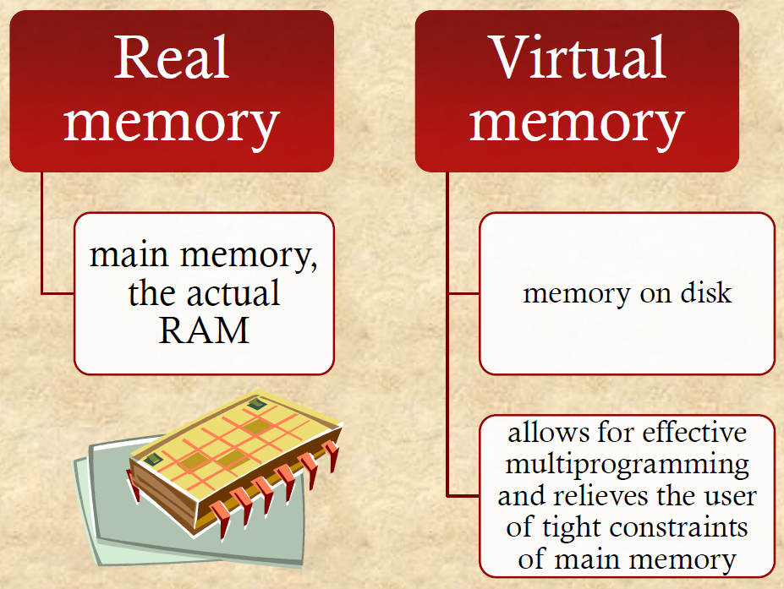
Real and Virtual Memory
Notes:
Real and virtual memory are forms of memory (internal storage of data). Real memory exists on chips (RAM memory) and on storage devices such as hard disks. Before a process can be executed, it must first load into RAM real memory.
Virtual memory is a process whereby data can be rapidly exchanged between physical memory storage locations and RAM memory. The rapid interchanges of data are seamless and transparent to the user. The use of virtual memory allows the use of larger programs and enables those programs to run faster.

Slide 30
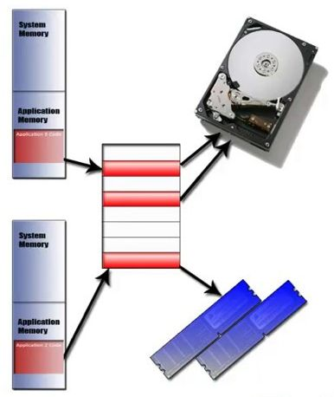
Difference between Virtual Memory and Physical Memory
Working speed: RAM is faster than hard disk.
Storage priority: Computer uses RAM as primary storage when memory is needed, and virtual memory as secondary storage.
Performance of programs: Reduced when they are in virtual memory.
Physicality: Physical memory is the memory installed on the motherboard, and virtual memory is a portion of hard disk.
Notes:
Main memory is faster than hard disk memory because main memory(RAM) works at nanoseconds whereas hard disk works at milliseconds. Virtual memory is stored on the hard drive. Virtual memory is used when the RAM is filled. Virtual memory is slower than physical memory, so it can decrease the performance of applications. The RAM is the first memory used when the computer requires memory usage. Virtual memory is a memory management technique

Slide 31
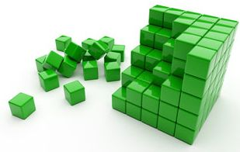
Modularity of Virtual Memory & Main Memory
Adding RAM: Setting up more
RAM modules to reduce
memory swaps.
Properties of RAM: Faster than hard disk
Limitation: RAM is volatile
and expensive.
Setting: As a temporary storage for currently running applications.
Notes:
Users can actively add RAM to a computer by buying and installing more RAM chips if they are experiencing slowdowns due to memory swaps happening too often.
The amount of RAM depends on what's installed on a computer.
Virtual memory, on the other hand, is limited by the size of the computer's hard drive.
Virtual memory settings can often be controlled through the operating system.

Slide 32
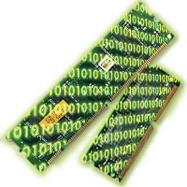
Classification of Virtual Memory
There are two ways to handle virtual memory:
Paged: Sections or paging files from memory.
Segmented: Virtual memory divided into segments
of varying length.
Notes:
There are two ways in which virtual memory is handled “paged” and “segmented”
Paging divides memory into sections or paging files.
When a computer uses up its RAM, pages not in use are transferred to the section of the hard drive designated for virtual memory using a swap file.
Segmentation is also used to manage virtual memory. This approach divides virtual memory into segments of different lengths.
Segments not in use in memory can be moved to virtual memory space on the hard drive.
Segmented information or processes are tracked in a segment table, which shows if a segment is present in memory, whether it's been modified and what its physical address is.

Slide 33
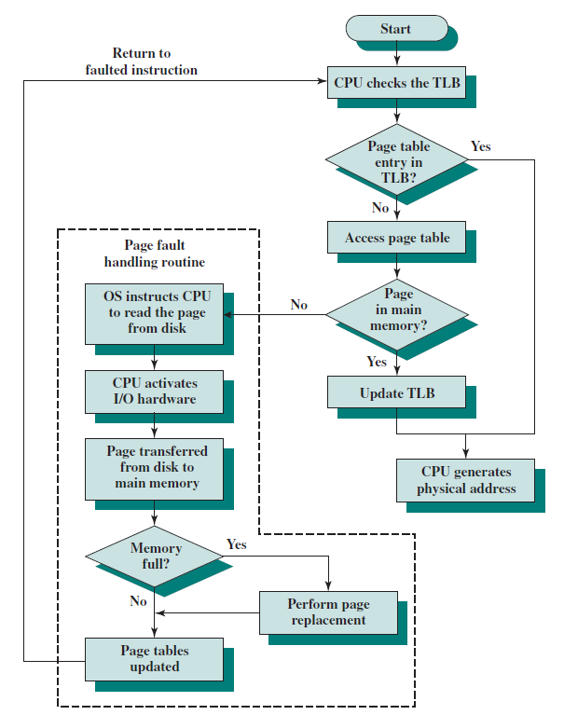
Paging and Segmented Difference
Memory Size
Accountability
Size
Speed
Table
Data storage
Notes:
1.In Paging, a process address space is broken into fixed sized blocks called pages. In Segmentation, a process address space is broken in varying sized blocks called sections.
2.Operating System divides the memory into pages. Compiler is responsible to calculate the segment size, the virtual address and actual address.
3.Page size is determined by available memory in paging. Section size is determined by the user in Segmented.
4.Paging technique is faster in terms of memory access. Segmentation is slower than paging
5.During paging, a logical address is divided into page number and page offset. During segmentation, a logical address is divided into section number and section offset.
6.Page table stores the page data. Segmentation table stores the segmentation data.

Slide 34
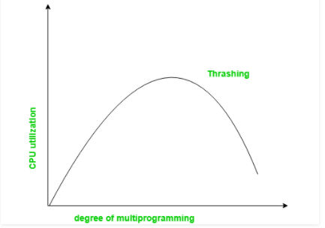
Thrashing
Notes:
When paging and page stealing are used, a problem called "thrashing" can occur, in which the computer spends an unsuitably large amount of time transferring pages to and from a backing store, hence slowing down useful work. A task's working set is the minimum set of pages that should be in memory for it to make useful progress. Thrashing occurs when there is insufficient memory available to store the working sets of all active programs. Adding real memory is the simplest response, but improving application design, scheduling, and memory usage can help. Another solution is to reduce the number of active tasks on the system. This reduces demand on real memory by swapping out the entire working set of one or more processes.
Thus, at any one time, only a few pages of any given process are in memory,
and therefore, more processes can be maintained in memory. Furthermore, time is
saved because unused pages are not swapped in and out of memory. However, the
OS must be clever about how it manages this scheme. When it brings one page in, it
must throw another page out; this is known as page replacement. If it throws out a
page just before it is about to be used, then it will just have to get that page again
almost immediately. Too much of this leads to a condition known as thrashing: the
processor spends most of its time swapping pages rather than executing instructions.

Slide 35
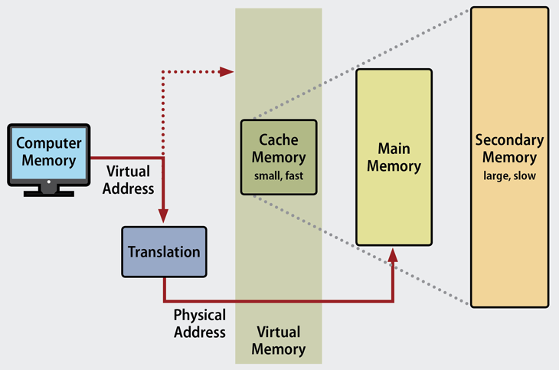
Management of Virtual Memory
Some hard disk space is allocated for virtual
memory by default.
Resetting the disk space allocation might be
necessary in some cases.
Notes:
Operating systems have default settings that determine
the amount of hard drive space to allocate for virtual memory.
That setting will work for most applications and processes,
but there may be times when it's necessary to manually reset
the amount of hard drive space allocated to virtual memory, such as
with applications that depend on fast response times or when
the computer has multiple HDDs.

Slide 36
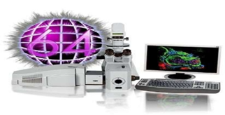
Advantages of Virtual Memory
Fit many large programs into smaller programs.
Multiple larger applications can be run simultaneously.
Allocating memory is relatively cheap.
Effective CPU use.
Shared pages during a fork system call.
Reduce memory usage to oppose pure paging.

Slide 37

Advantages of Virtual Memory
● Can handle addresses twice as main memory.
● Memory Isolation increased security.
● Paging or Segmentation allow
more memory than actual memory.
● Allow multiprogramming environment.
● More applications can be run at the
same time.
● Simplifies memory Allocation.
Notes:
https://www.guru99.com/virtual-memory-in-operating-system.html
some of the point taken from original ppt

Slide 38
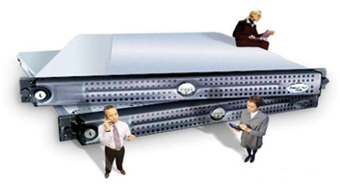
Disadvantage of Virtual Memory
Applications may run slower.
Likely takes more time to switch between applications.
Offers lesser hard drive space.
It reduces system stability.
It doesn't offer the same performance as RAM.
Thrashing can occur if the RAM is too small.
Notes:
The use of virtual memory has its tradeoffs, particularly with speed. It's generally better to have as much physical memory as possible, so programs work directly from RAM or physical memory.
The use of virtual memory slows a computer because data must be mapped between virtual and physical memory, which requires extra hardware support for address translations.
The size of virtual storage is limited by the amount of secondary storage, as well as the addressing scheme with the computer system.
Thrashing can happen if the amount of RAM is too small, which will make the computer perform slower.
It may take time to switch between applications using virtual memory.
The use of virtual memory has its tradeoffs, particularly with speed. It's generally better to have as much physical memory as possible, so programs work directly from RAM or physical memory.
The use of virtual memory slows a computer because data must be mapped between virtual and physical memory, which requires extra hardware support for address translations.
The size of virtual storage is limited by the amount of secondary storage, as well as the addressing scheme with the computer system.
It may take time to switch between applications using virtual memory.
Thrashing can happen if the amount of RAM is too small, which will make the computer perform slower.
https://www.guru99.com/virtual-memory-in-operating-system.html

Slide 39


